Slide 1




CAR SALES DATASET

Slide 2


INTRODUCTION TO
Car Sales Dataset
Dataset Dates: January 2, 2022- December 31, 2023.
23,906 car purchases
Purchases made at car dealerships across 7 regions in the United States
L

Slide 3

OBJECTIVE OF DATA ANALYSIS
Analyze who our customers are,
what they are buying,
and what their purchasing patterns are.

Slide 4
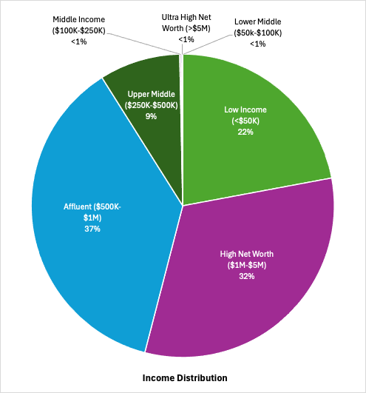
CUSTOMER INCOME BRACKET
69% or 16,490 customers
are in the “Affluent” or “High Net Worth” Income brackets

Slide 5

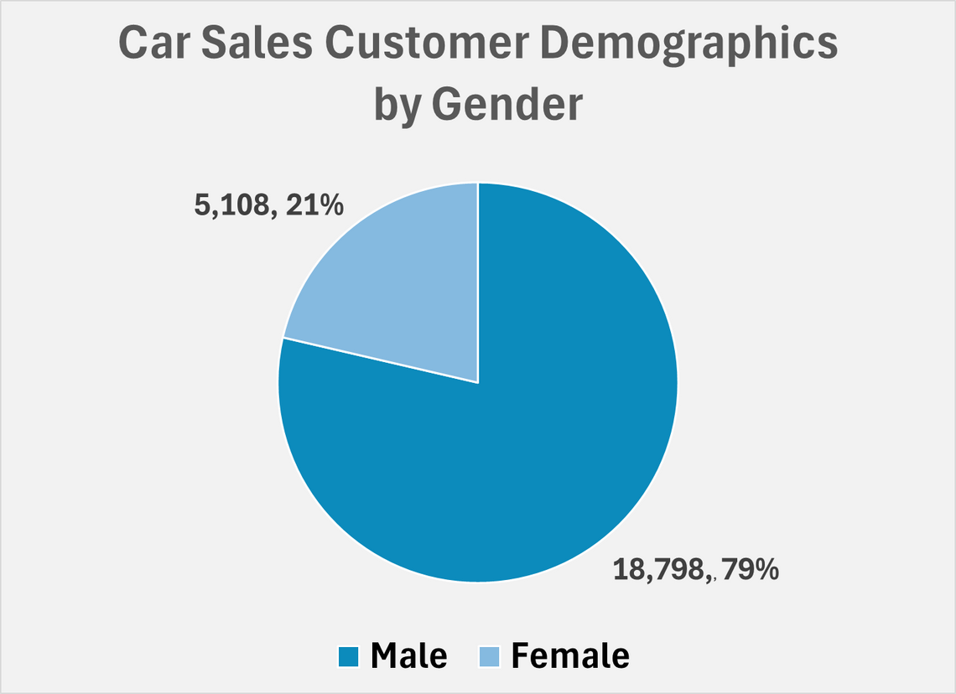
CAR SALES BY GENDER

Slide 6
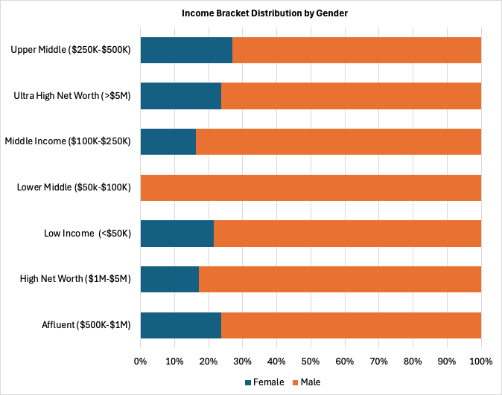
CUSTOMER INCOME BRACKET BY GENDER
Women on average make up
~20% of each income bracket, except “Low Middle” income (0%)

Slide 7

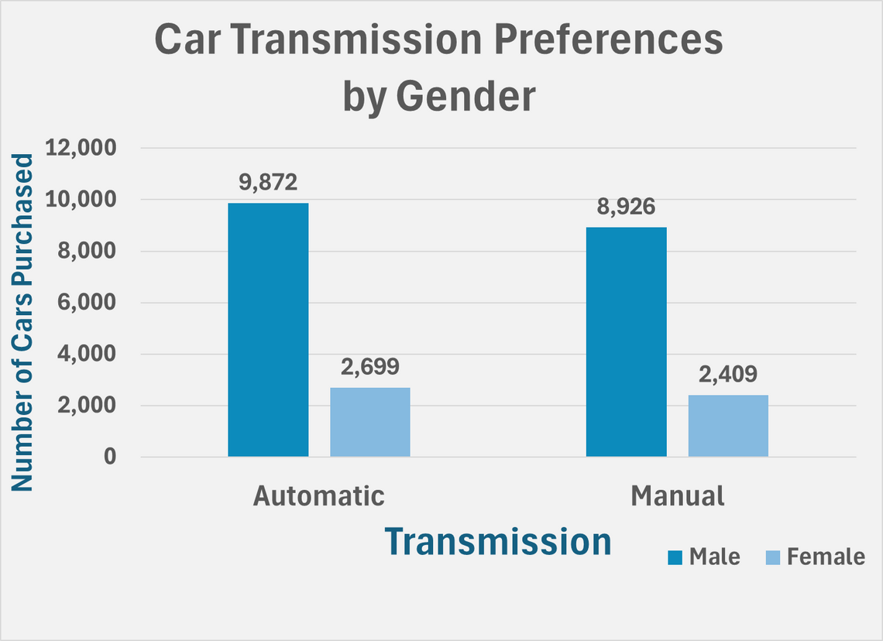
CAR TRANSMISSION PREFERENCES
BY GENDER

Slide 8

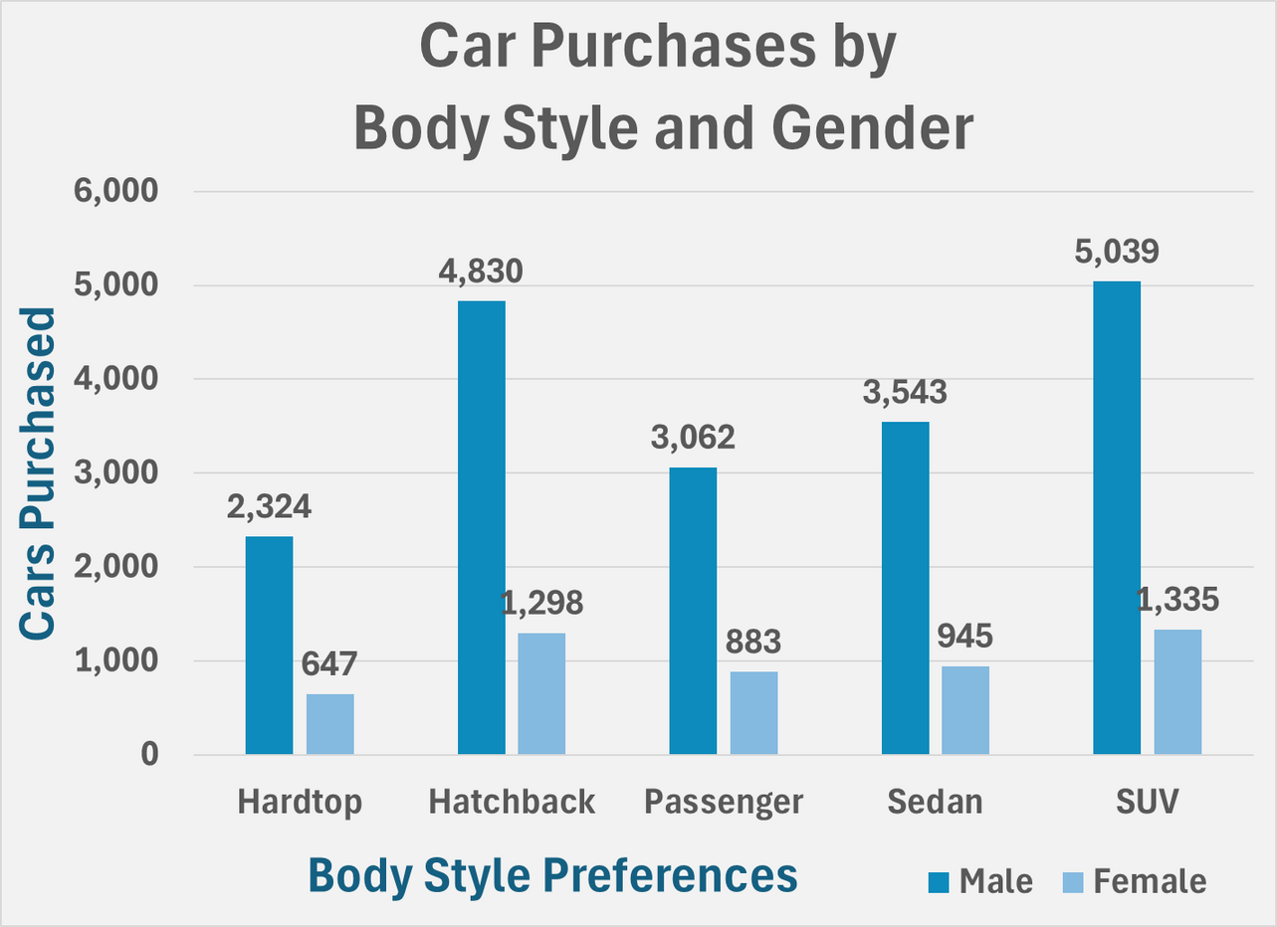
BODY STYLE PREFERENCES
BY GENDER

Slide 9

DEALERSHIP REGION RANKINGS
Dealership Region | % Change in Sales
Austin, TX | +24.69%
Janesville, WI | +23.33%
Scottsdale, AZ | +25.51%
Aurora, CO | +24.55%
Greenville, SC | +24.49%
Pasco, WA | +21.89%
Middletown, OH | +20.21%

Slide 10
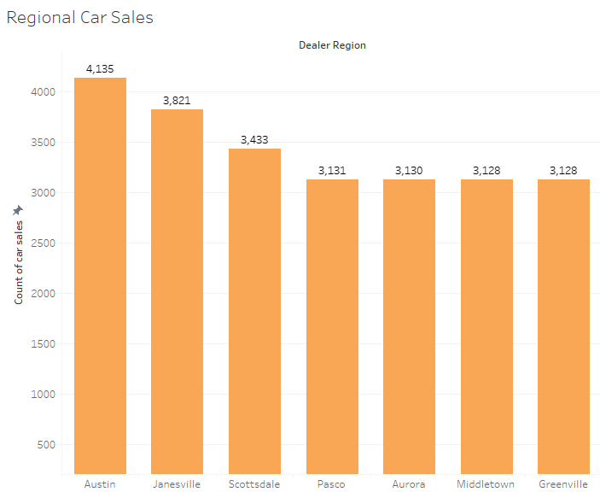
TOTAL SALES BY REGION
There is a significant lead in the amount of cars sold in Austin, Texas, and Janesville, Wisconsin
Austin region has 32%, and Janesville has a 22% increase in sales compared to the average sales across regions.

Slide 11
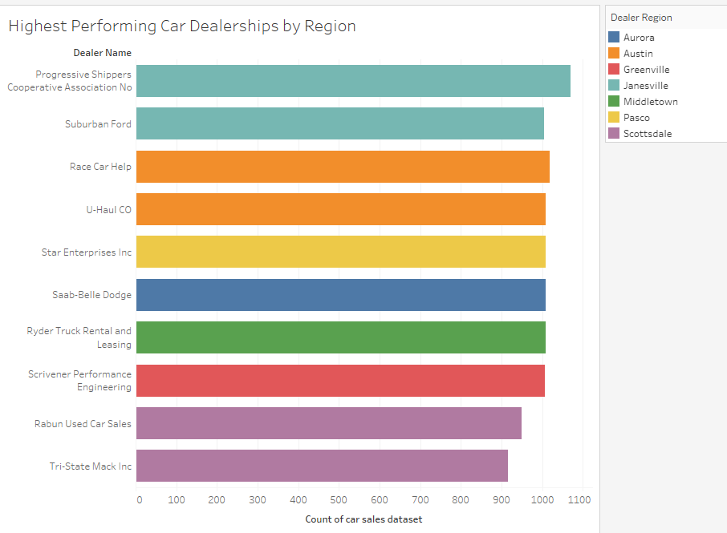
TOTAL SALES BY REGION
Progressive Shippers lead the list along with Suburban Ford, located in Janesville.
U-Haul CO suggests strong commercial vehicle sales, and Race Car Help is more about professional racers.
The Austin, Texas, market is very specific and not about commercial use.

Slide 12
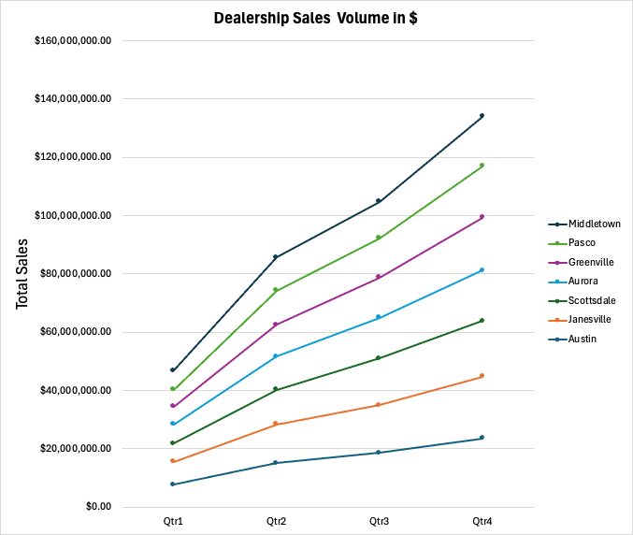
DEALERSHIP REGION SALES VOLUME

Slide 13
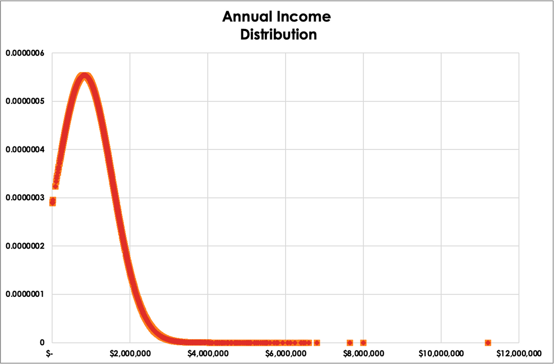
CUSTOMER INCOMES
A probability density function was graphed to show the incomes of customers
The x-axis represents customer incomes while the y-axis represents the density, or likelihood of having that income
The distribution is not normal, and is right-skewed with the majority of earners being on the “lower end”, peaking at $1M
There are a few outliers towards the tail of the distribution
This graph creates the potential to create tiers for our customers, (low/mid/ and high income)
Based on their tier they customers will have different needs such as financing, premium models, exclusive offers, etc
This also helps us with inventory optimization aligning the majority of our customers to the type of vehicle those with $1M income purchase the most

Slide 14
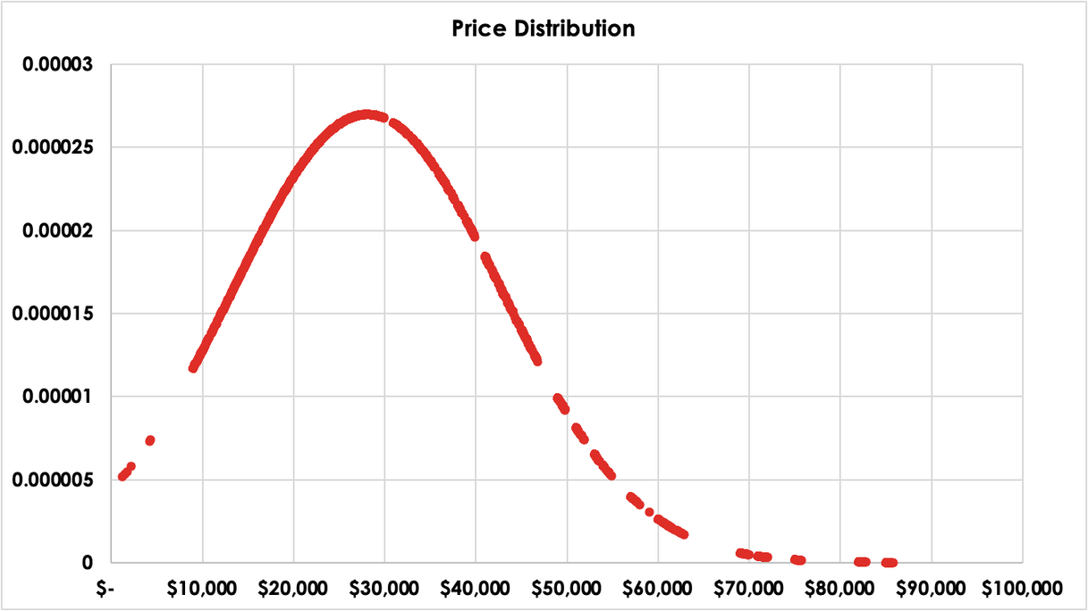
VEHICLE PRICE DISTRIBUTION
A probability density function was graphed to show the price distribution of vehicles
The x-axis represents vehicle price while the y-axis represents the density, or likelihood of having that vehicle price
Price is also right skewed with most price being within $20-40K, with a rapid decline afterwards
There are a few outliers towards the tail of the distribution
The sweet spot for inventory is to focus on having $20-40K models in stock
This also helps us with inventory optimization aligning the majority of our customers to the type of vehicle those with $1M income purchase the most
Further analyses showed there was not a strong relationship between cutomer income and the vehicle they decided to purchase, thus it makes the most sense to not hold too much inventory below $20K or above $40K in cost.

Slide 15
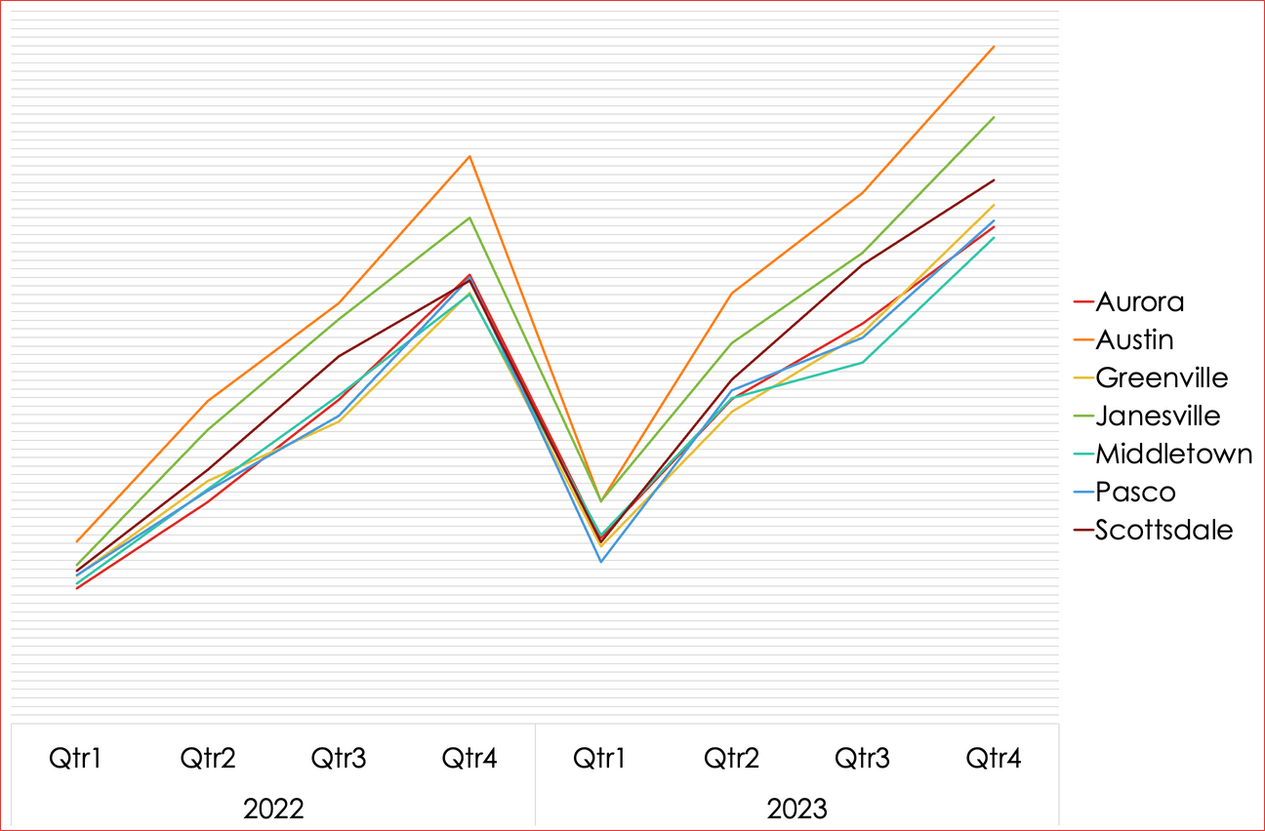
VEHICLE SALE SEASONALITY
Evaluating the seasonality of Sales we can see clear trends which apply to dealership independent of its location
Sales are at their lowest in the first quarter, January through March
There needs to be greater incentives to push the sales during these months even higher, this is the time offer new incentives and make targeted campaigns to boost sales during these sluggish months

Slide 16
RECOMMENDATIONS
We are recommending that dealerships focus on prioritizing vehicles between $20-40K as the majority of the inventory as income and vehicle price are not correlated.
Another suggestion to the dealerships is to focus on promotions that are at the beginning of the year, as the first quarter is significantly slower than the rest of the year.
We are prioritizing SUVs and Hatchbacks for our inventory as these models tend to sell the most across genders

Slide 17
ANY QUESTION?

Slide 18

THANK YOU

